Slide 1
Demand Forecasting

Slide 2
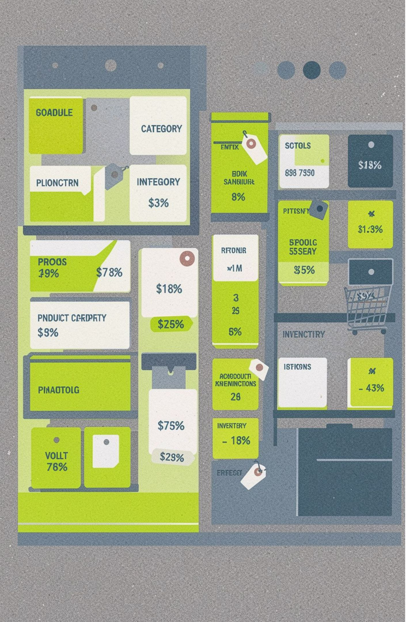
Project overview
Analyse customer shopping behaviour from 76,000 purchases across project categories
01
Uncover insights into demand, sales, inventory, and category performance to guide strategic business decisions
02
02

Slide 3



Dataset summary
76,000
Key features
No
stores, products, sales, inventory, pricing, promotions, weather, seasonality, and demand
rows and 16 columns
missing data
03

Slide 4
Exploratory data analysis using Python
01
02
03
04
05
Imported the dataset using pandas
Used df.info() to check structure and df.describe() for summary statistics
Checked for null values and confirmed there were no null values in the dataset
Renamed columns to snake case for readability and documentation
Changed the Date column from string type to datetime type
04

Slide 5



Business questions answered with Python
Total demand
Minimum demand
Region-wise demand analysis
Average demand
Maximum demand
Category-wise demand, units sold, and prices
05

Slide 6
Discounts and promotions affect demand
Demand versus discount analysis asks whether higher discounts lead to higher demand
Promotion-wise demand analysis asks whether running a promotion increases average demand
Finding: higher discounts lead to higher demand
Finding: stakeholders should promote their business to increase demand
06

Slide 7
Data analysis using SQL
01
02
03
04
05
Changed the datatype of the date column from string to date type
Checked total demand and total units sold
Checked average price
Analysed demand and units sold by region
Analysed promotion, seasonality, and demand over years
07

Slide 8
Dashboards bring the analysis together
Combine the source dashboards into a clear view of demand, regional performance, category performance, promotions, seasonality, and trends over time.
Demand
Regional performance
Category performance
Promotions
Seasonality
Trends over time
08

Slide 9
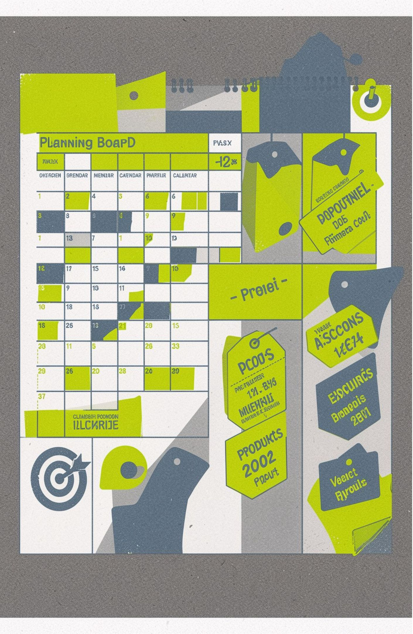
Business recommendations
Promotion: demand was higher in promotional periods, so use promotional strategies to stimulate business growth
Discount: customer demand is usually higher when a higher discount is given, so try to give more reasonable discounts to customers
Targeted marketing: focus on high-revenue-generating products and highlight top-rated products
09

Slide 10
Conclusion
Demand forecasting analysis connects customer behaviour, pricing, promotions, seasonality, and regional performance to strategic business decisions.

